Slide 1
Pomelo—基于Node.js的游戏服务器框架
网易
谢骋超
@圈圈套圈圈
@xiecc

Slide 2
Category
The state of pomelo
Overview
Framework
Practice
Evolution
Performance

Slide 3

The state of pomelo
Fast, scalable, distributed game server framework for node.js
Realtime application server framework.
Open sourced
V0.2.0 2012.11.20
V0.3.0 2013.3.8

Slide 4
Pomelo定位
Realtime application server framework
Game server framework
Mobile game
Web game
Social game
Large MMO RPG

Slide 5
Comments of
感谢网易为中国的node.js社区做出最佳贡献
这玩意意义重大
我觉得，所有程序员都可以细读我们开源的游戏服务端框架pomelo的《pomelo架构概览》，服务器抽象、路由、请求类别、两类channel、应用与模块管理、filter中的AOP思维、惯例优先等，处处可见精巧的工程设计。
Node.js要火了

Slide 6

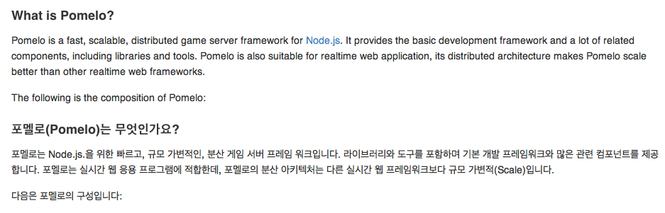
Pomelo社区

Slide 7
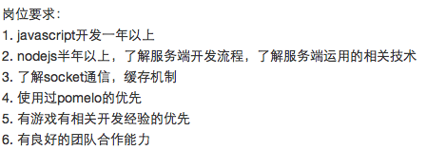
Pomelo社区

Slide 8
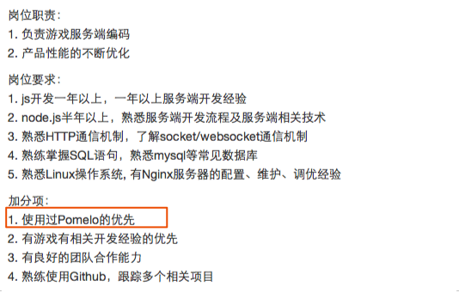
Pomelo社区

Slide 9

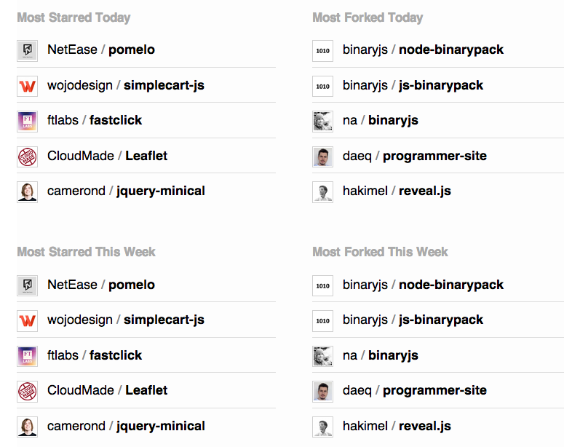
Pomelo社区

Slide 10
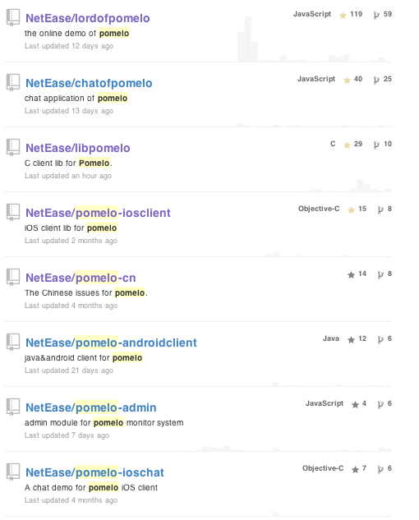
State of pomelo
Pomelo is not a
single project
Almost 30 repos in total

Slide 11
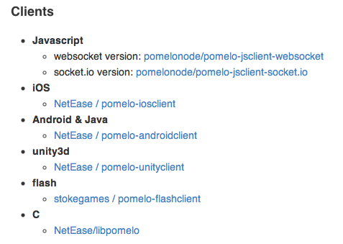
State of pomelo -- clients

Slide 12
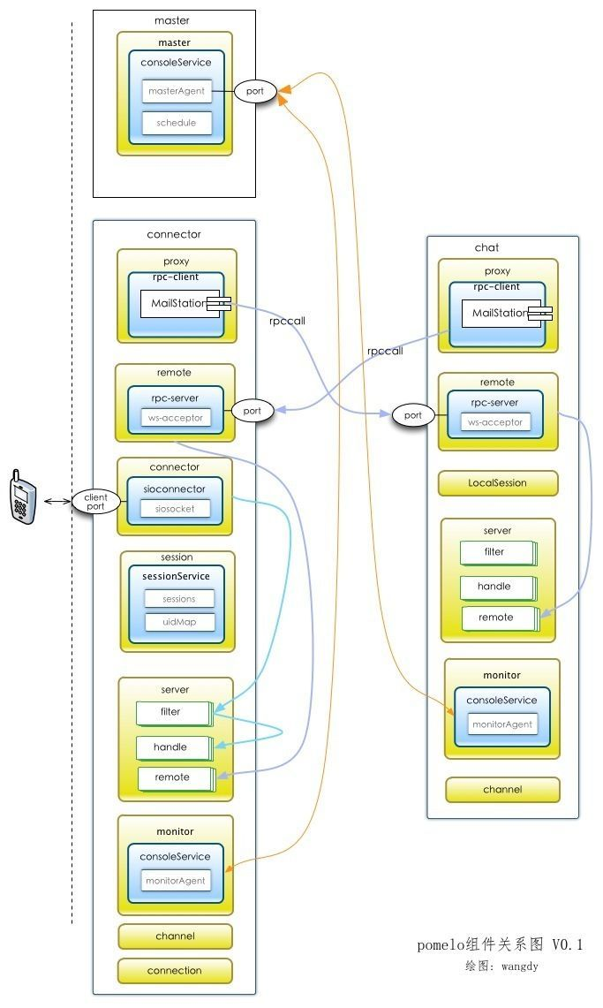
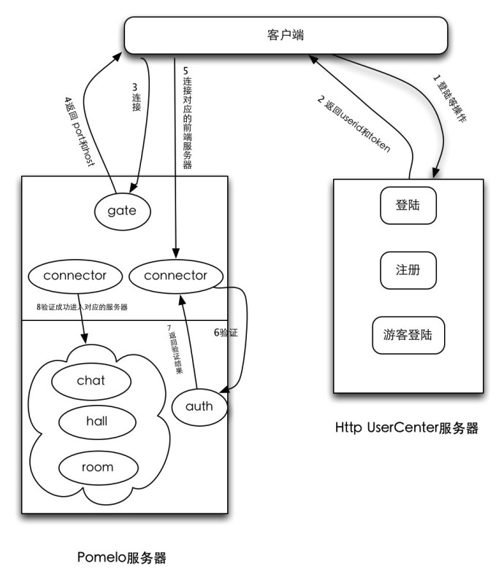
State of Pomelo – code
Code reading in community

Slide 13
State of pomelo
Realtime application
网易消息推送平台，已上线
Games
N款移动网络游戏正在开发中

Slide 14
Category
The state of pomelo
Overview
Framework
Practice
Evolution
Performance

Slide 15
Overview---node.js and game server
Node.js is a platform built on Chrome's JavaScript runtime for easily building fast, scalable network applications. Node.js uses an event-driven, non-blocking I/O model that makes it lightweight and efficient, perfect for data-intensive real-time applications that run across distributed devices.
Game Server
Fast Scalable
Network Real-time

Slide 16
Overview --- node.js advantages
Scalability -- event driven I/O
Game, high density network communication
Language, javascript
Browser, HTML5, unity3d, cocos2d-x, other platform – same language in client and server
Lightweight, development efficiency, really quick iteration
Multi-Process, Single thread
No lock
Simple

Slide 17
Overview – node.js disadvantage
Some CPU sensitive actions
Path finding
AI
Solution
Optimization
Divide process
All can be solved in practice

Slide 18
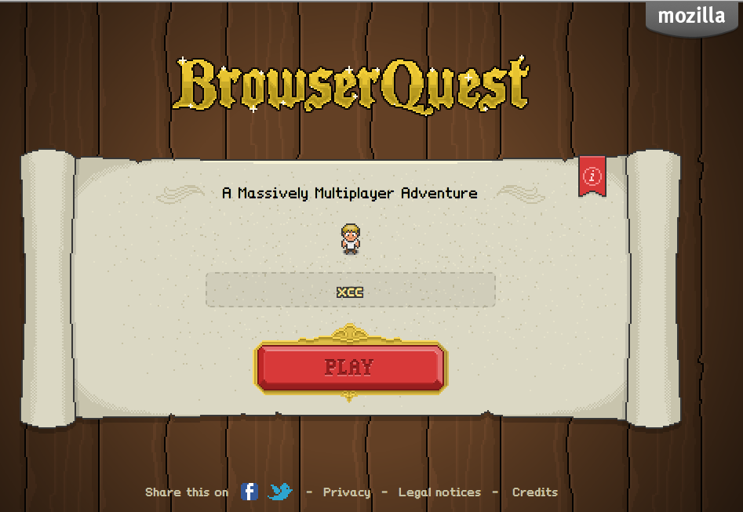
Node.js game—Mozilla BrowserQuest

Slide 19
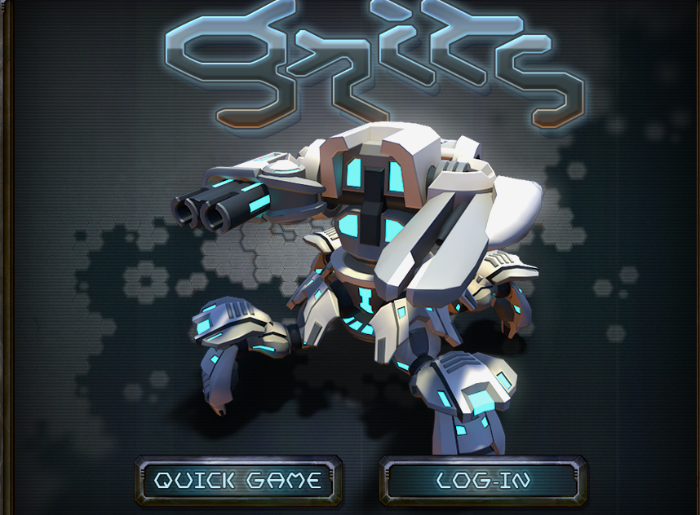
Node.js game—google gritsgame

Slide 20
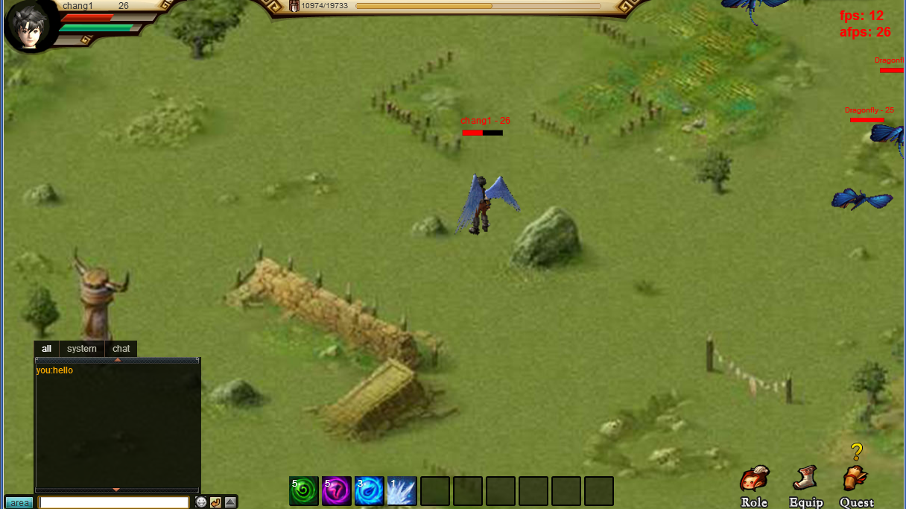
Overview -- our demo
http://pomelo.netease.com/lordofpomelo

Slide 21
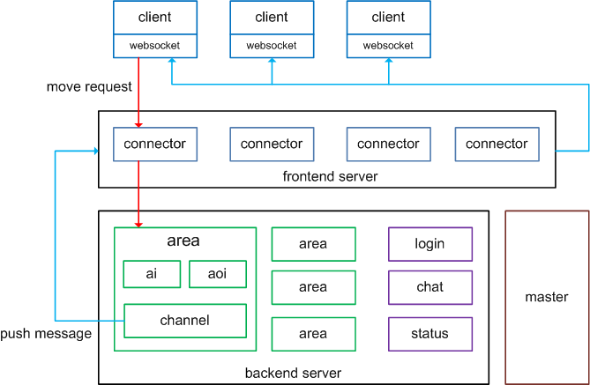
Overview---architecture of demo

Slide 22
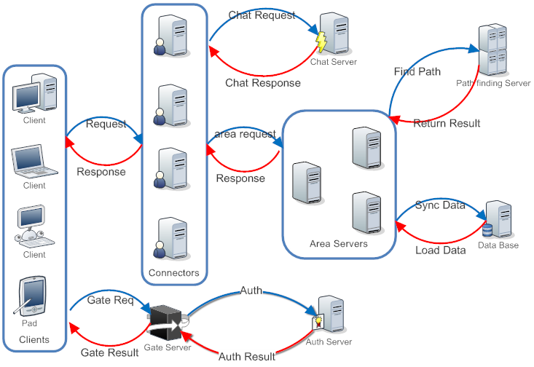

Slide 23
Overview --- game VS web
Long connection VS Short connection
Partition: area based VS Load balanced cluster
Stateful VS Stateless
Request/Broadcast VS Request/response

Slide 24
Problem
Distributed development is hard, is it?
How many codes for this complicated architecture?
A lot of servers and server types, how to manage?
The server side rpc is complicated, how to simplify?
A lot of processes
How many servers do we need？
How to spot the problem on multiple servers？
Is it too heavy, not efficient?

Slide 25

Overview --- how to solve complexity
Too … complicated?
solution: framework

Slide 26
With pomelo
Pomelo makes distributed development really easy and pleasant
Achieve this architecture---almost zero Code
Server types and servers extention --- simple
Servers rpc --- simple，zero config, no stub
A lot of processes
One machine, small amount of resources
Single console，quick spot problem, no different to single process
Lightweight, extremely quick to start up

Slide 27
Category
The state of pomelo
Overview
Framework
Practice
Evolution
Performance

Slide 28

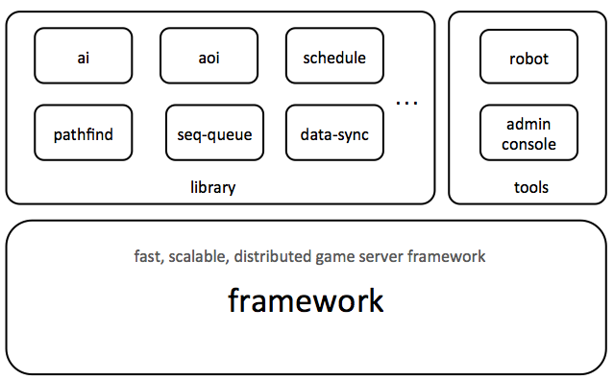
Framework ---

Slide 29
Framework --- design goal
Abstract of servers(processes)
Auto extend server types
Auto extend servers
Abstract of request , response and broadcast
Zero config request
Simple broadcast api
Other mechanisms: filter, session
Servers communication---rpc framework

Slide 30
Framework --- server abstraction
Why the name of node.js?
Why web do not need server abstraction?
Web is stateless
Load balancer, nginx, apache
Cluster frameworks
Why server abstraction in pomelo framework?
Game is stateful
Multi-processes cooperate for one task

Slide 31
Framework --- server abstraction
master
backend
forward message
frontend
push message
by channel
backend
rpc
backend
frontend
backend

Slide 32
Framework --- server abstraction
Frontend（connector）
Client connection
Maintain session information
Dispatch request to backend
Push message to client
Backend
Handle request from frontend
Push messages to frontend, through channel or response
Rpc service

Slide 33
Framework--- server abstraction
Duck type
connector
area
chat
frontend
backend
status

Slide 34
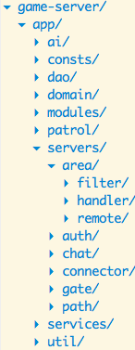
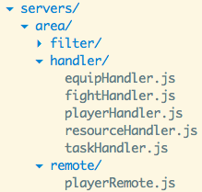
Server abstraction
The Duck
servers

Slide 35
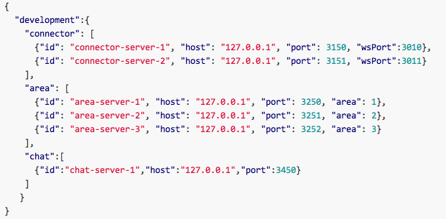
Framework---server abstraction

Slide 36
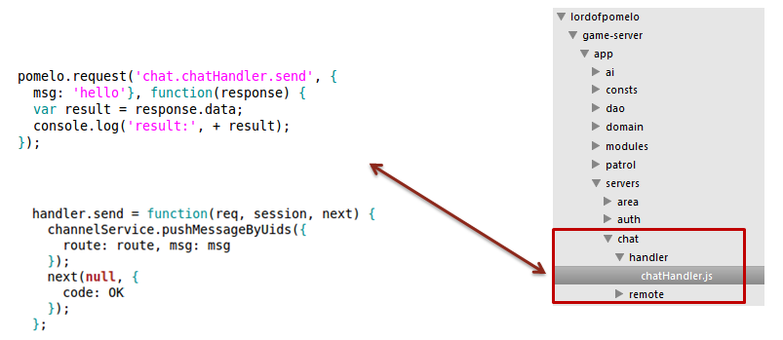
Framework --- request abstraction
Zero config
Client, like ajax
Server, like web mvc framework

Slide 37
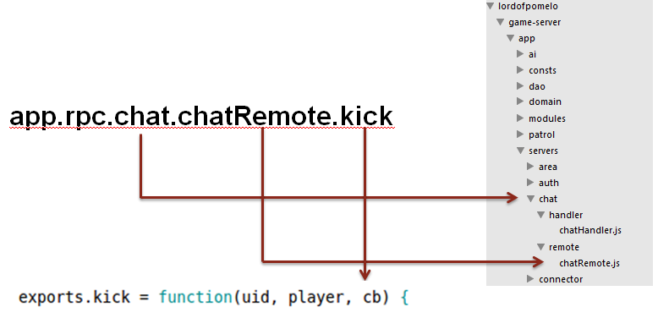
Framework -- rpc framework

Slide 38
Framework – rpc framework
Why rpc is so easy in pomelo?
Thrift
Writing a .thrift file
Generate Thrift file to source code
thrift --gen <language> <Thrift filename>
Copy the source to application
Pomelo—start up, all done
Client and server in one project
Servers folder convention
Auto generate proxy and remote on start up

Slide 39
Framework --- channel&broadcast
Push messages to a group of users
channelService.pushMessageByUids(msg, uids, callback);
var channel = channel.getLocalChannelSync(‘area1’);
channel.pushMessage(msg);

Slide 40
Framework --- channel&broadcast
broadcast
client1
channel
regroup
connector1
Easy API
Most frequent action
Potentially performance problem
uids1
uids
client2
…
connector2
uids2
clientn
…
…
client
connectors
area

Slide 41
Category
The state of pomelo
Overview
Framework
Practice
Evolution
Performance

Slide 42
Practice --- game demo
Develop time(first version): 2012-5-14~2012-6-30
Client
Html 5, based on colorbox framework
Almost 6,000 lines code
Server
Node.js, based on pomelo framework
Almost 6,000 lines code

Slide 43
Practice --- simplest player move
client1
1、Move request
Area1
2、Forward
3、Move Handler
connector
client2
4、Backward
…
5、Broadcast
clientn
6、Play move animation
client

Slide 44
Practice --- Client Move Request
… find path, move animation
pomelo.request({route:’area.playeHandler.move’, path: path}, function (result){
…
});

Slide 45
Practice --- area server handler
handler.move = function( req, session, next) {
… verify path
… handle move
channelService.pushMessagesByUids(
route:’onMove’,
….);
next(null, {code:OK});
}

Slide 46
Practice --- client play move
pomelo.on(‘onMove’, function(data) {
play move animation
…
});

Slide 47
Practice --- character move
Character Move, isn’t that easy?
In reality , it’s hard

Slide 48
Practice --- handle move
Different situations
Player move, mob move
AI driven or player driven
Smooth effect
Client prediction
Latency Compensate
How to notify
AOI(area of interest)

Slide 49
Category
The state of pomelo
Overview
Framework
Practice
Evolution
Performance

Slide 50
Evolution
From game server to realtime application framework
We originally designed pomelo for game server, it ends up to be a realtime application server framework
The core of pomelo have nothing related to game server
It turn out to be a better application server framework

Slide 51
Why is pomelo better
Why pomelo is a better realtime application framework?
Meteor
Meteor is an ultra-simple environment for building modern websites. What once took weeks, even with the best tools, now takes hours with Meteor.
Socketstream
Derby
Web is not the only client side, the rise of the mobile
Is fast development the most important feature, or scalability?

Slide 52
Why is pomelo better
A server supports multiple clients
Web , mobile, PC clients, seamlessly connected
Adaptible for different protocol--socket.io is perfect for browser, but not for mobile
Scalability
Distributed architecture
Take full advantage of CPU

Slide 53
Pomelo connector
Pomelo component Loader
Connector
MQTTConnector
SIOConnector
HybridConnector
Mobile client
Socket.io client
Socket, websocket
client

Slide 54
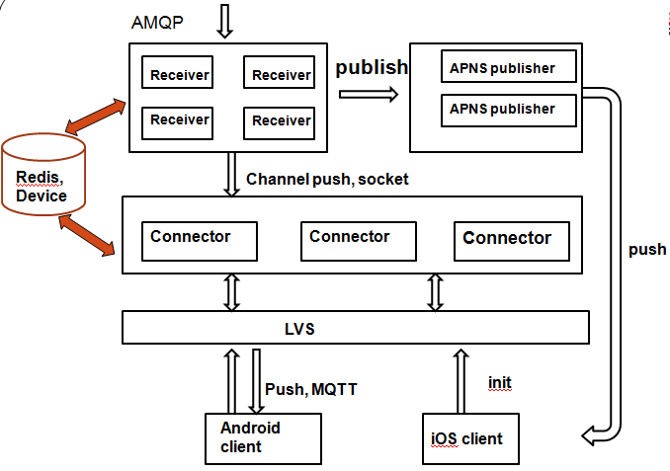
消息推送平台 in netease

Slide 55
网易消息推送平台
Based on pomelo and rabbitmq
QOS1保证，保证消息的到达率。支持离线消息
支持android与iOS， 采用MQTT协议，iOS推送通道可选择长连接或APNS
支持Web端，采用socket.io协议
支持其它PC客户端，采用socket协议

Slide 56
Evolution
We used to assume HTML5, flash as mainstream, it turned out to be mobile
移动端游戏开发者占绝大多数
跨平台， 客户端：
cocox2d-x
unity3d
iOS
android,
HTML5
Flash
数据包的大小， json is too wasteful，需要压缩数据

Slide 57
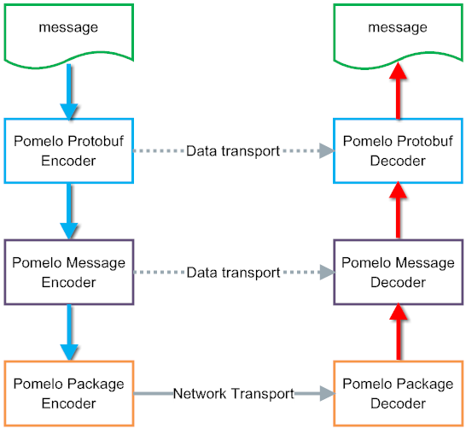
Message encode, decode

Slide 58
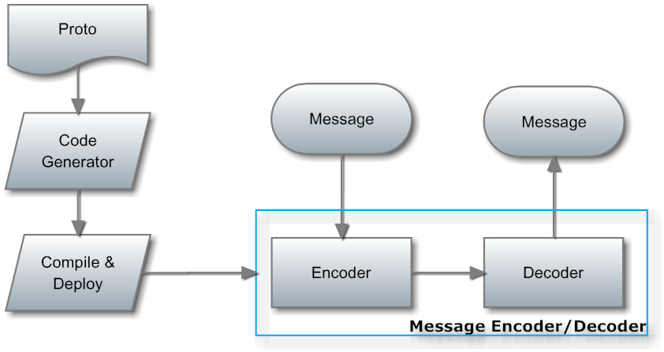
数据压缩--- pomelo protobuf
Original protobuf

Slide 59
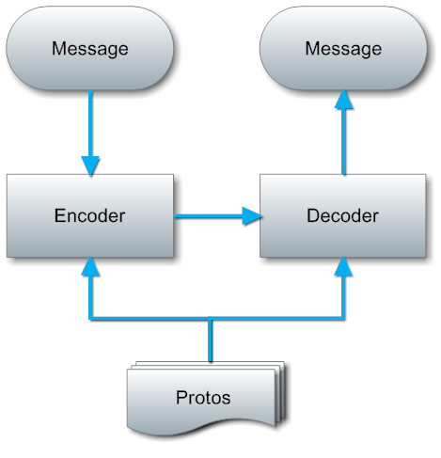
数据压缩---pomelo protobuf

Slide 60
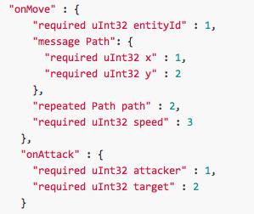
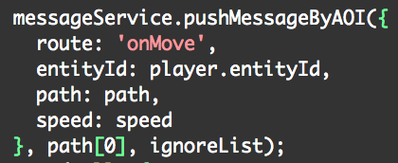
数据压缩---definition

Slide 61
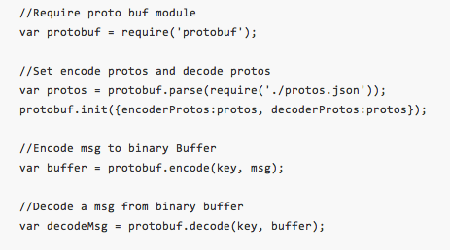
Pomelo protobuf
https://github.com/pomelonode/pomelo-protobuf
As an independent project

Slide 62
Category
The state of pomelo
Overview
Framework
Practice
Evolution
Performance

Slide 63
Performance
Different application performance criteria
Game(especially MMO)
High network density, high frequence of broadcast
Stateful, area limitation, can not scale well
Online user is low, 1000 onlines per area, 7000 onlines per game is a miracle
Realtime application
Middle network density, connectors hold long connections
Stateless, can be scale well
Online user is high
Memory is bottleneck

Slide 64
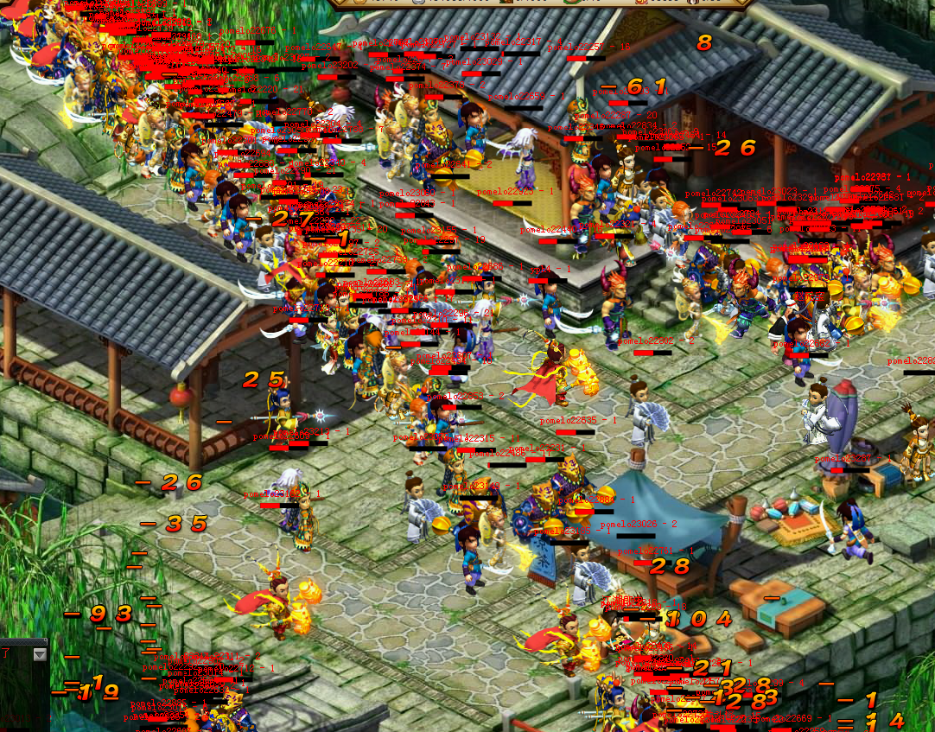
Game performance --- stress testing

Slide 65
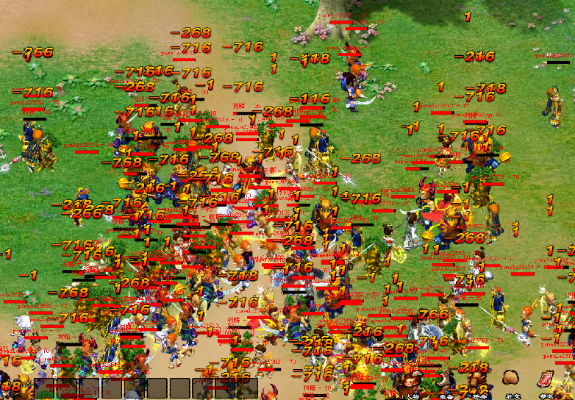
Game performance --- stress testing

Slide 66
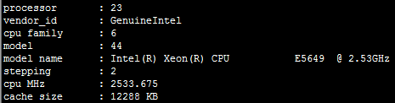
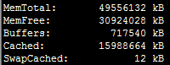
Performance --- hardware
CPU , 24 cores
Mem, 48G

Slide 67
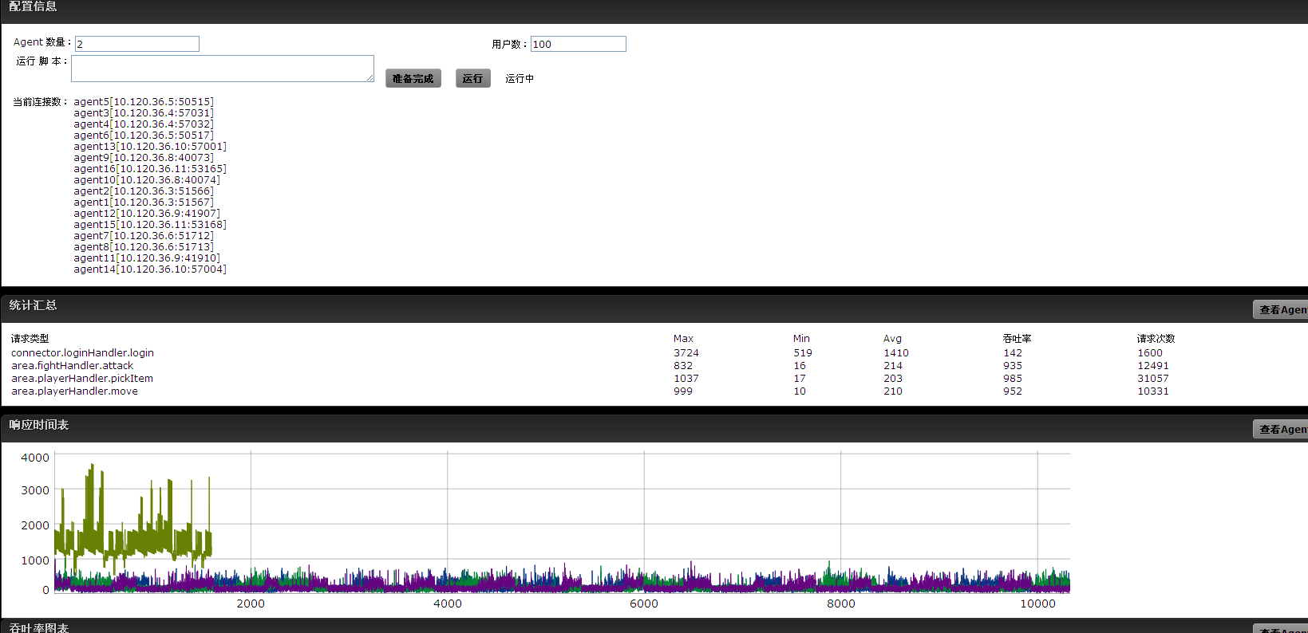
Performance --- the result
1600 onlines

Slide 68
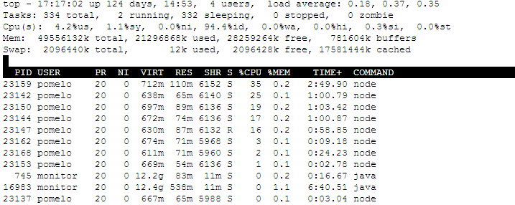
Performance --- the result
1600 onlines , server load

Slide 69
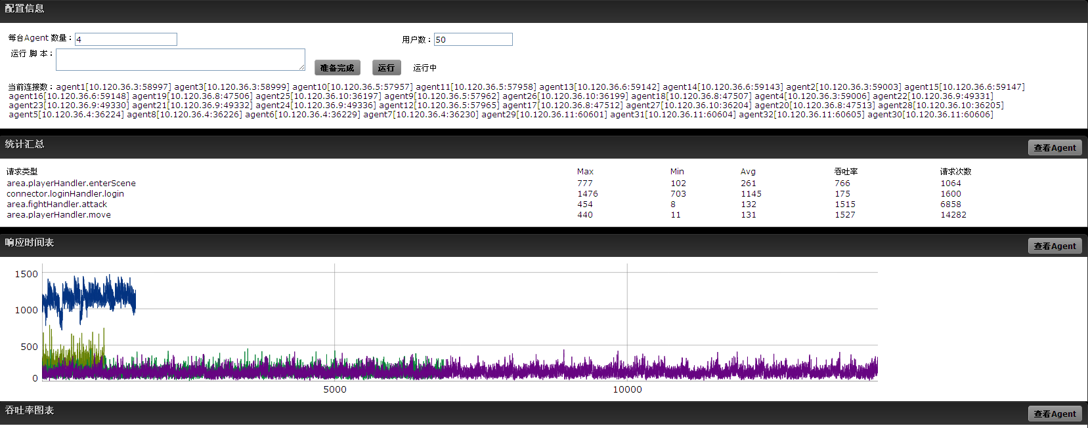
Performance --- the result
800 onlines, fight each other

Slide 70
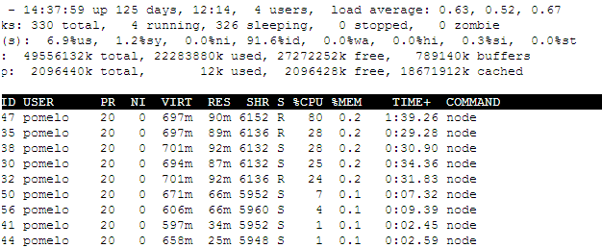
Performance --- the result
Server load, fight each other

Slide 71
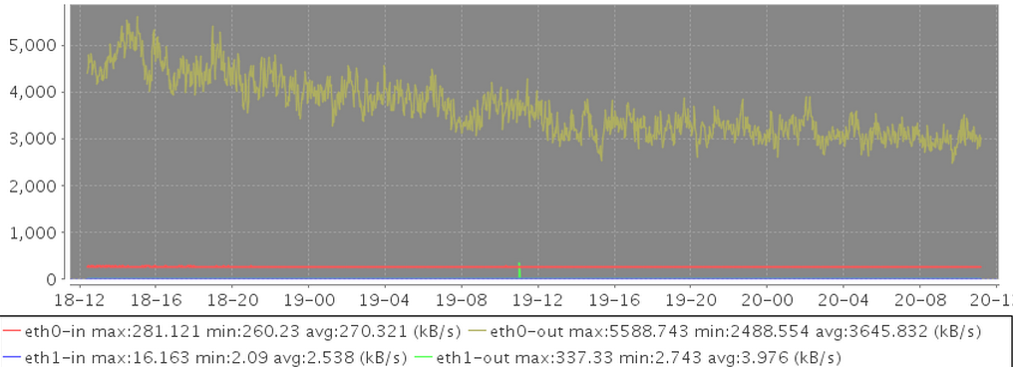
Pomelo Netflow – V0.2
Version 0.2, 400 online users
Out: 3645Kb/S in: 270Kb/s

Slide 72
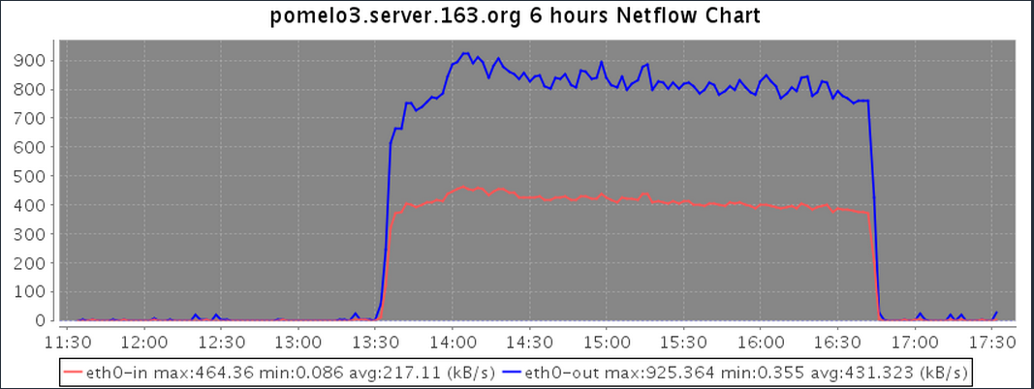
Pomelo Netflow – V0.3
Version 0.3, 400 online users
Out: 925KB/S, in: 217KB/S, 1/4 Netflow of 0.2

Slide 73
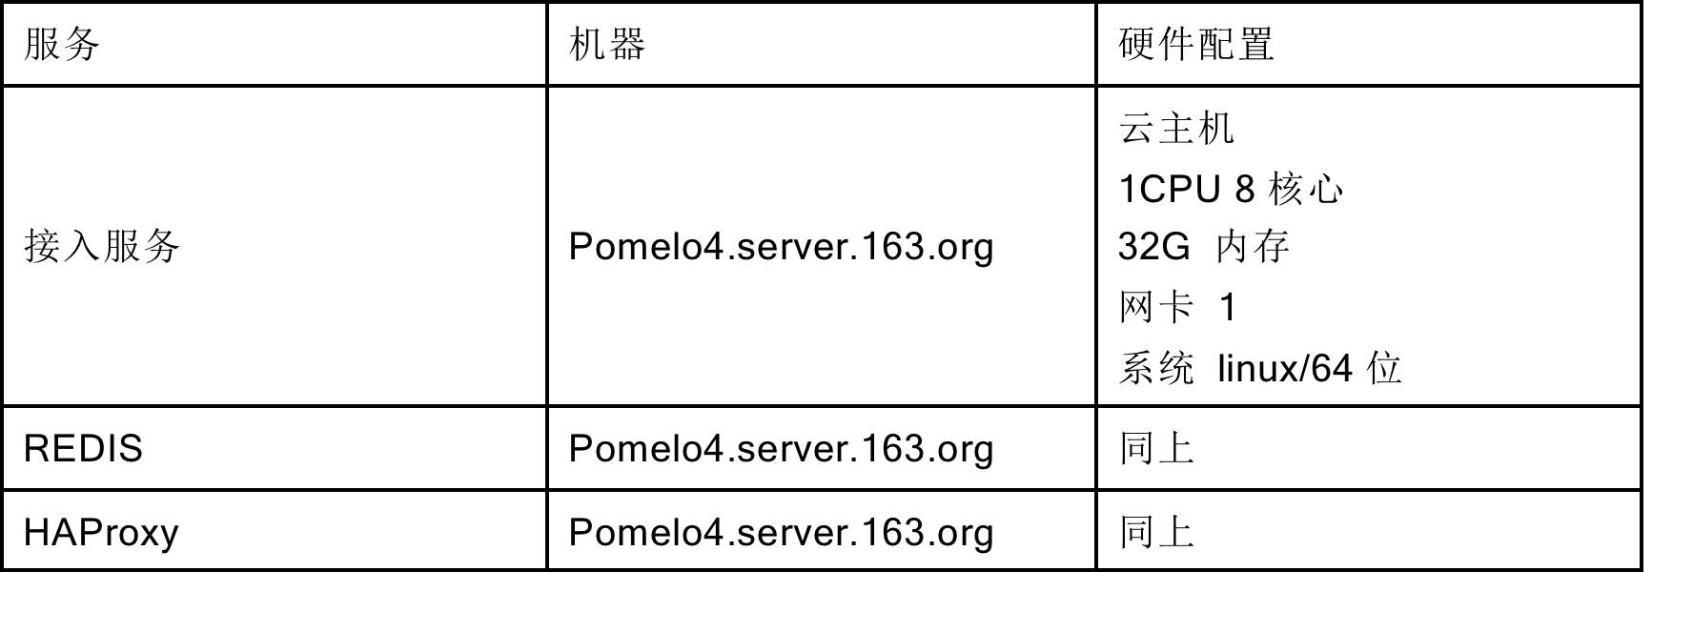
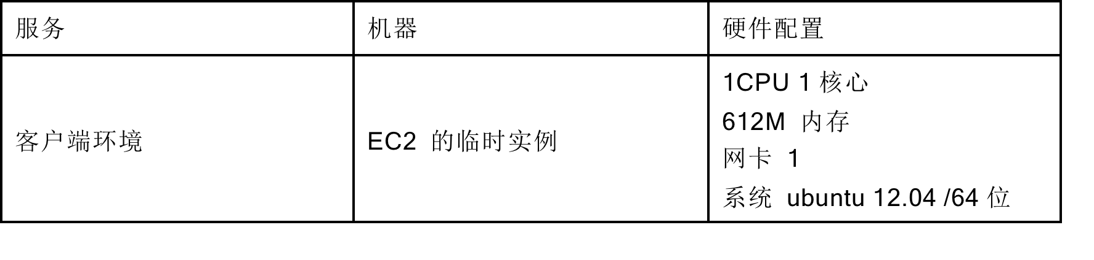
消息推送平台performance
Server
Client

Slide 74
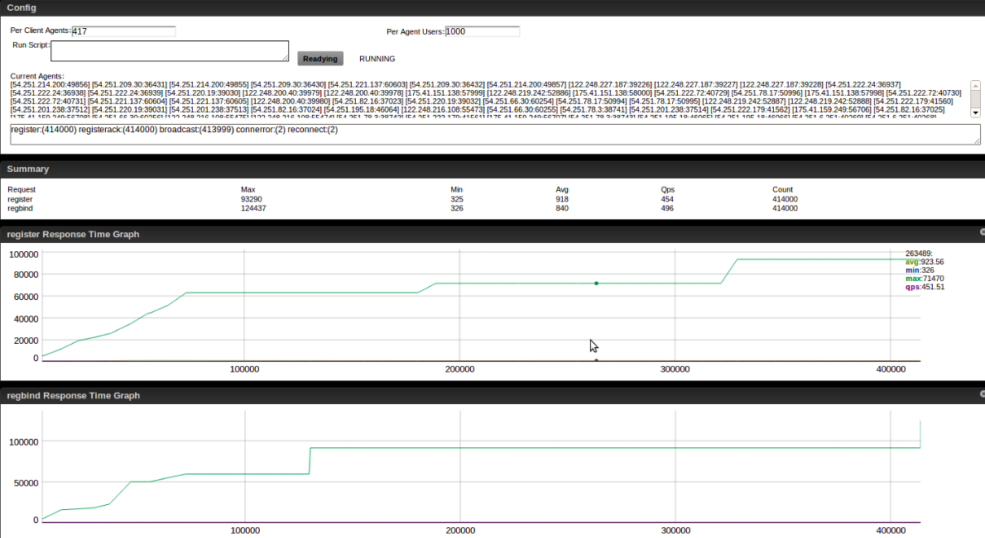
消息推送平台
8 connectors, 41.7万个连接

Slide 75
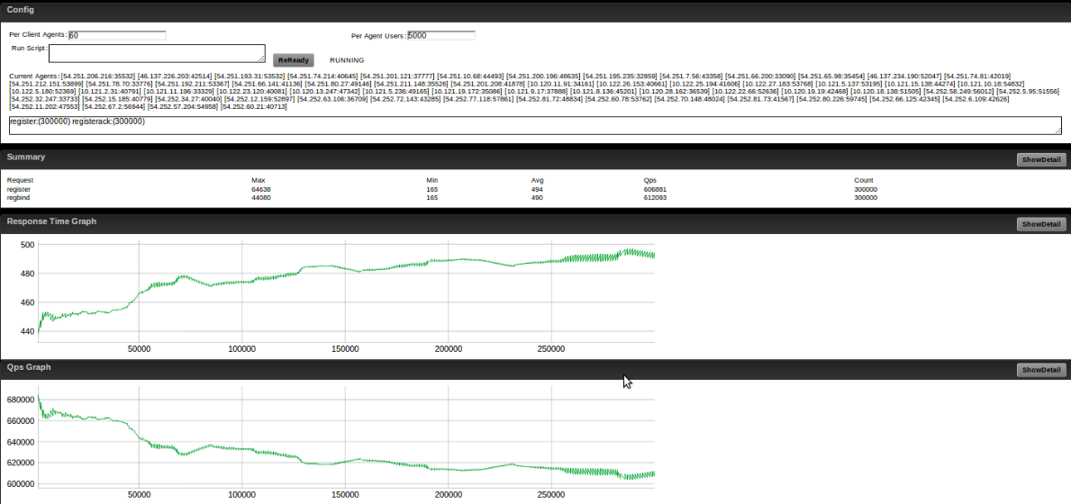
消息推送平台
1 connector, 30万连接，no gc, 3G内存

Slide 76
参考资料
https://github.com/NetEase/pomelo/
https://github.com/pomelonode/pomelo-protobuf
http://pomelo.netease.com
http://nodejs.netease.com

Slide 77
Q&A

